Slide 1
Lead ammunition and fishing tackle - Draft restriction proposal -
REACH Committee meeting of 27 February 2025
Patrizia TOSETTI; DG GROW

Slide 2
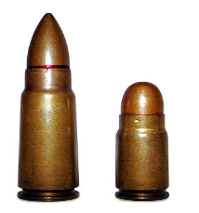
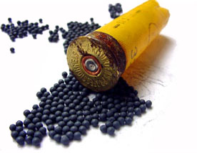
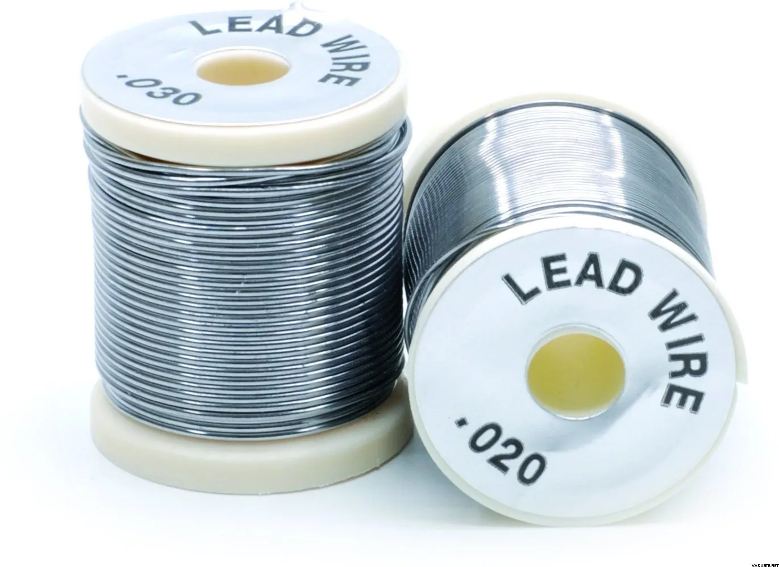
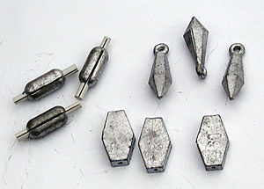
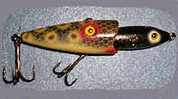
Scope - Ammunitions and fishing tackle
Ammunition
Bullet
Shot
(inc. slugs)
Containing 1% lead
or more
For use with shotguns
For use with pistol, rifle, carbin, etc
Fishing Tackle
Wire
Sinkers
Lure

Slide 3
Restriction of lead ammo/fishing tackle General approach
Use of product = release of lead?
High emissions (not preventable)
No or low emissions
Preventable emissions
Use ban
Permanent
derogation
Derogation
Sale ban
(some uses
only)
Time-limited
RMM
Transitional
periods
Review after 10 years (certain derogations only)
Information, labelling and marking requirements
MILITARY/SECURITY USES = OUT OF SCOPE

Slide 4
Gunshot - Restricting measures
HUNTING (shot)
SPORTS SHOOTING (shot)
Prohibition to use (discharge and carry)
TP = 3 years
1 generic derogation (historic firearms)
Prohibition to use (discharge and carry)
TP = 5 years
Conditional derogation proposed
Prohibition to place on the market (both uses)
TP = 5 years
Conditional derogation for sports shooting
1 generic derogation (historic firearms)

Slide 5
Gunshot - Generic derogation for historic firearms
Placing on the market
(shot)
HUNTING
SPORTS SHOOTING
Generic derogation:
Gunshot for
- muzzle-loading guns - historic firearms
Use (carrying and dischaging)
(shot)

Slide 6
Gunshot - Conditional, time limited derogations for sports shooting
SPORTS SHOOTING (shot)
Both derogations
Time-limited to 15 yr
Review after 10 yr
Limited to 1.9-2.6 mm shot sizes
Limited to members of sports shooting federations
Limited to authorised shooting ranges
Autorisation conditional to RMM (TP = 5 yr)
Record keeping and reporting obligations (every 5 yr)
Derogations from the ban on:
Placing on the market
(shot)
Use (carrying and dischaging)
(shot)

Slide 7
Mandatory RMM for gunshot
Appendix X lists the mandatory RMM for outdoor sports shooting ranges where gunshot is discharged: Specific lead-containment measures (walls, berms, nets, etc) Recovery of spent lead shot at least every 3 years and upon cessation of activity of the outdoor sports shooting range; Ensuring that gunshot-impact areas have a pH of between 6.5 and 8.5; Containment, monitoring and, where necessary, treatment of drainage water from gunshot-impact areas A ban on any agricultural use within the site’s boundaries

Slide 8
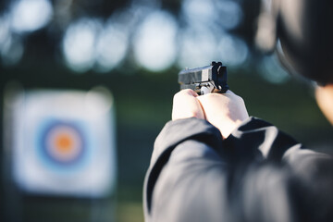
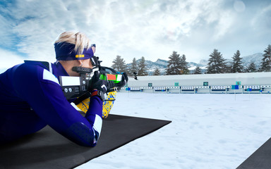
Bullets - Restricting measures
HUNTING (bullets)
SPORTS SHOOTING (bullets)
Prohibition to use (discharge and carry)
TP = 1,5 yr for calibres ≥ 5,6 mm
TP = 10 yr for calibres < 5,6 mm
TP = 10 yr for rimfire bullets
Derogations proposed for niche uses
Prohibition to use (discharge and carry)
TP = 5 years
Derogation proposed for outdoor shooting ranges
No prohibition to place on the market

Slide 9
Bullets - Derogations from the ban on use (discharge/carry)
HUNTING (bullets)
SPORTS SHOOTING (bullets)
Derogations from ban on use:
bullets for seal hunting (if permitted)
full-metal-jacket bullets
Derogations from ban on use :
outdoor sports shooting ranges (review after 10 yr)
traditional events and funfairs
Generic derogations from ban on use (not use-specific):
Bullets for muzzle-loading guns and historic firearms
bullets containing copper and copper alloys with < 3% lead w/w

Slide 10
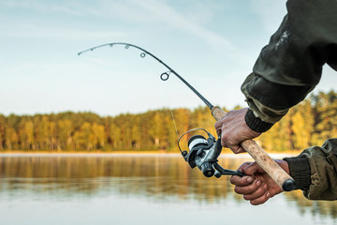
Fishing tackle - Restricting measures
FISHING
Prohibition to use and place on the market lead
in sinkers and in lures ≤ 50 g (TP = 3 yr)
in sinkers and in lures > 50 g (TP = 5 yr)
in fishing wires and in drop-in sinkers (TP = 6 months).
Derogations proposed

Slide 11
Fishing tackle - Derogations
FISHING
Derogations from ban on use and placing on the market:
lures containing copper and copper alloys with < 3% lead w/w;
split shot weighing 0.06 g or less (if spill-proof and child-resistant packaging).

Slide 12
Information requirements - Retailers
Retailers of gunshot, bullets, fishing sinkers, and lures – including online retailers – need to display warnings to consumers next to the products for sale:
‘WARNING: this product contains lead which is very toxic to the environment and may damage fertility or the unborn child.”
“The use of lead in ammunition and fishing tackle is restricted in the EU from [follows a list of restricted products and application dates].”
“More information, including on the availability of lead-free alternatives, is available at [www.echa.europa.eu]
TP = 6 months

Slide 13
Labelling requirements - Gunshot or bullets packaging
Suppliers of gunshot or bullets shall ensure that: the packaging of those products is labelled with a warning statement: ‘WARNING: this product contains lead which is very toxic to the environment and may damage fertility or the unborn child.
TP = 18 months

Slide 14
Marking requirements - individual cartridges or bullets
Suppliers of gunshot or bullets shall ensure that:
individual bullets or gunshot cartridges are clearly, visibly and indelibly labelled with the marking:
‘Pb’
TP = 5 years

Slide 15
MS obligations
authorise an outdoor sports shooting range for use with gunshot only following verification that RMM are in place. make publicly available the instructions and procedure for authorising sports shooting ranges (for use with gunshot) make publicly available a list of authorised sports shooting ranges report amount of gunshot supplied and recovered on their territory to the Agency every 5 years

Slide 16
Out of scope
Indoor shooting; Police, law enforcement and other security applications; Military and defence applications; Protection of critical infrastructure, commercial shipping or high-value convoys; Protection of public buildings and public space; Self-defence Technical testing and proofing of guns and ammunition; Testing and development of materials and products for ballistic protection; Forensic analysis; Historical and technical research or investigation; Primers and wads

Slide 17
Thank you
© European Union 2025
Unless otherwise noted the reuse of this presentation is authorised under the CC BY 4.0 license. For any use or reproduction of elements that are not owned by the EU, permission may need to be sought directly from the respective right holders.
Photos used in slides 4 to 15 are from Adobe Stock (https://stock.adobe.com/)

